Slide 1
UWP Apps DX Hack November 2015
Team Beats
Notes:
Who are you?
Current Microsoft graduate working
Where do you work?
Developer Experience group
What are you going to talk about?

Slide 2
Technical what?
@dotjson
Notes:
What is a Technical Evangelist at Microsoft?

Slide 3
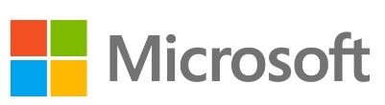
Make a Windows 10 Universal App
Goal :
You get an app that can display a heart rate from your Band on any device – a phone, or any PC even a Raspberry PI 2 or any other device capable of running some form on Windows 10 - anywhere in the world.
I just deployed the app to three totally different types of devices and… it just works. It almost feels like cheating.
Hammer home the concept of the Universal Windows Platform.
Notes:
What does Microsoft offer students?

Slide 4
So what were the extra bits

Slide 5

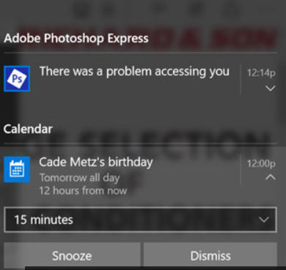
Enhance the Windows Experience
Goal :
Use Notification to prompt user to rest or get active based on heart rate
Use Groove music API to allow users to select to play calming
music or
active music depending
on heart rate
Use Windows Notifications to prompt users
Notes:
What does Microsoft offer students?

Slide 6
How did we get here?
Yes, on the train… on a plane and by tube
@dotjson
Notes:
Non narcissistic version of my story

Slide 7
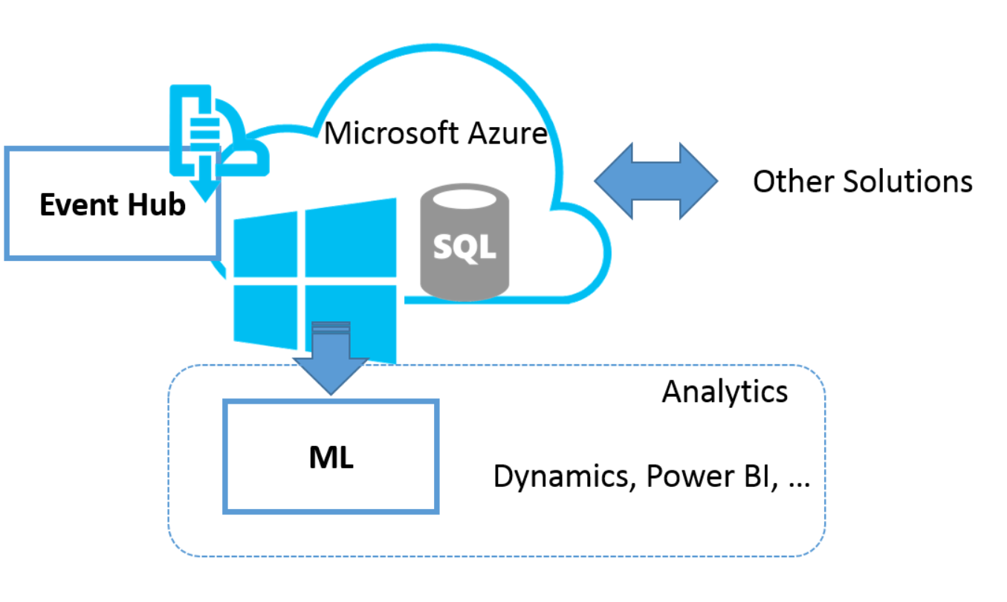
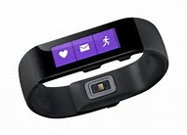
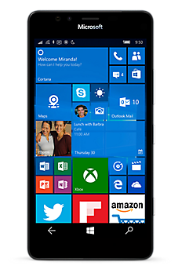


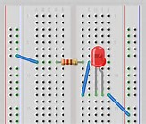
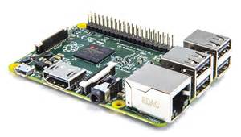
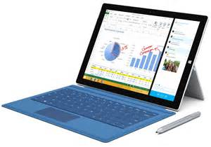

Slide 8
What Apps Services did we use
Azure EventHub
Azure WebSite
Windows 10 UWP Adaptive Web App
Windows 10 IoT Core
Microsoft Band SDK
Groove Music API
Notifications

Slide 9
Demo

